Slide 1
CO 2
Session no. 18

Slide 2
LINK STATE ROUTING
In link state routing, if each node in the domain has the entire topology of the domain, the node can use Dijkstra’s algorithm to build a routing table.
The topics discussed in this section include:
Building Routing Tables

Slide 3
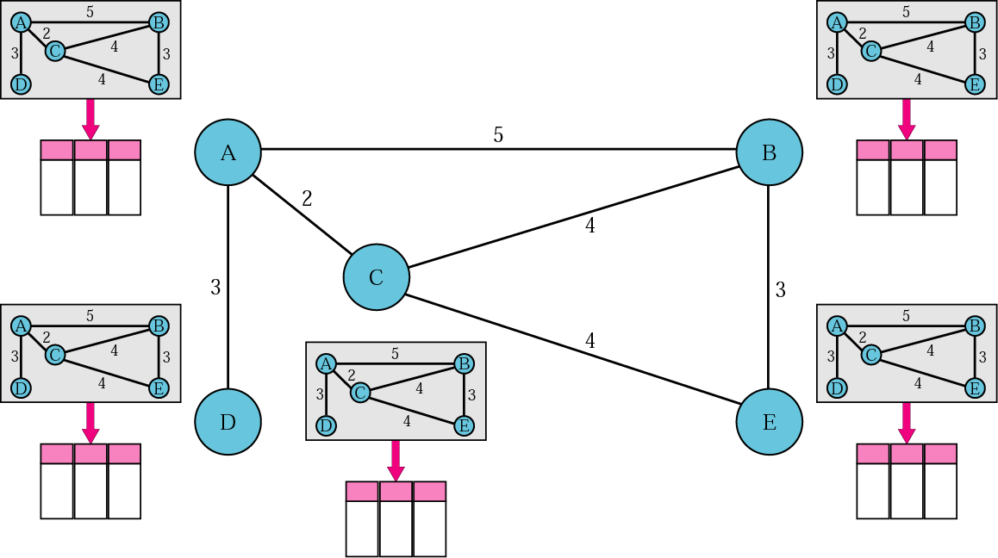
Figure. Concept of link state routing

Slide 4
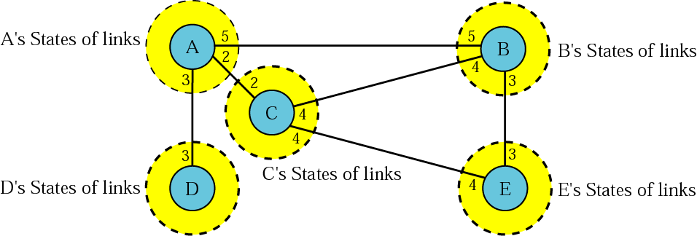
Figure. Link state knowledge

Slide 5
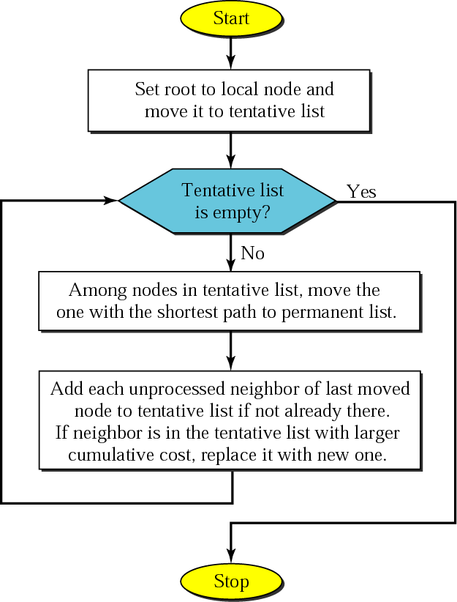
Figure. Dijkstra algorithm

Slide 6
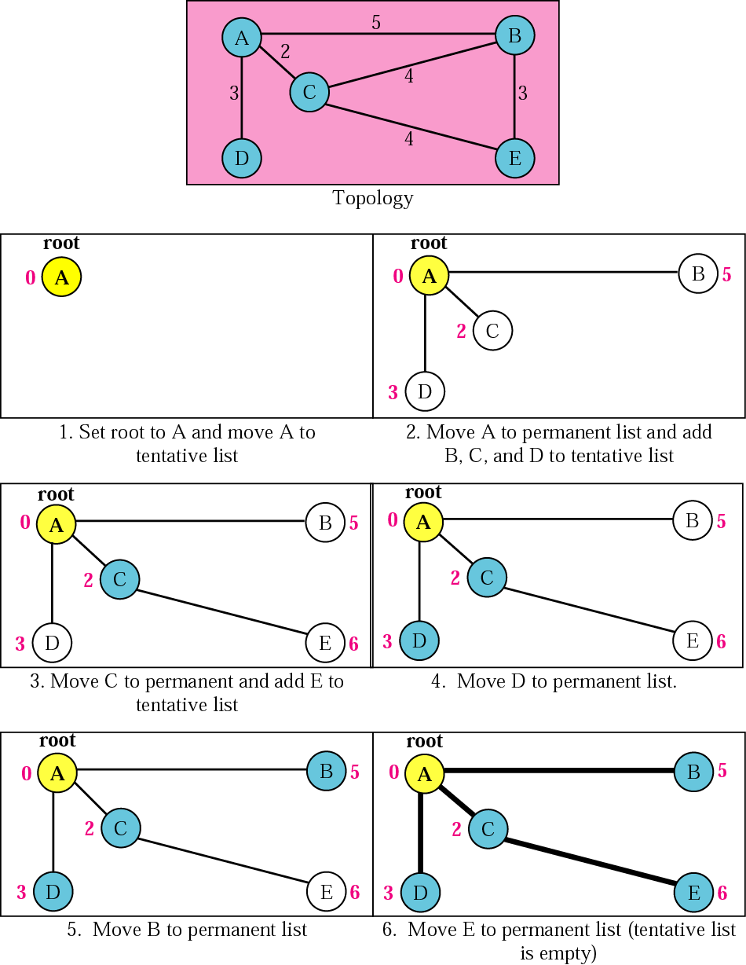
Figure. Example of formation of shortest path tree

Slide 7
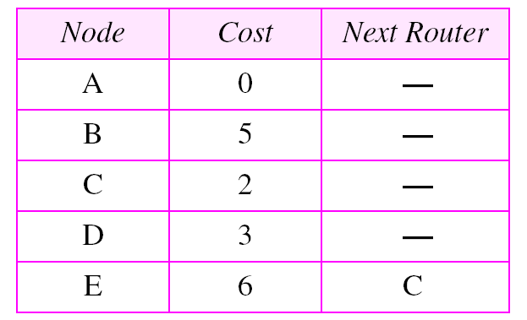
Table. Routing table for node A

Slide 8
OSPF
The Open Shortest Path First (OSPF) protocol is an intradomain routing protocol based on link state routing. Its domain is also an autonomous system.

Slide 9
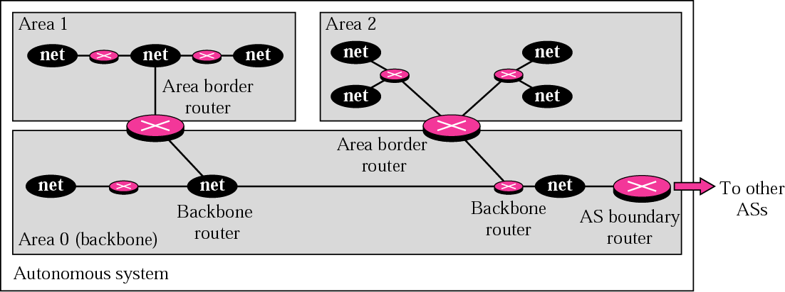
Figure Areas in an autonomous system

Slide 10
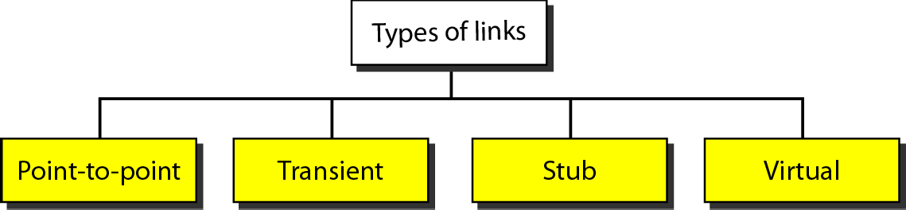
Types of links

Slide 11
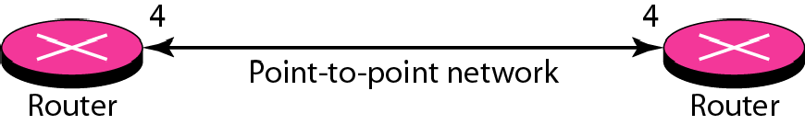
Point-to-point link

Slide 12
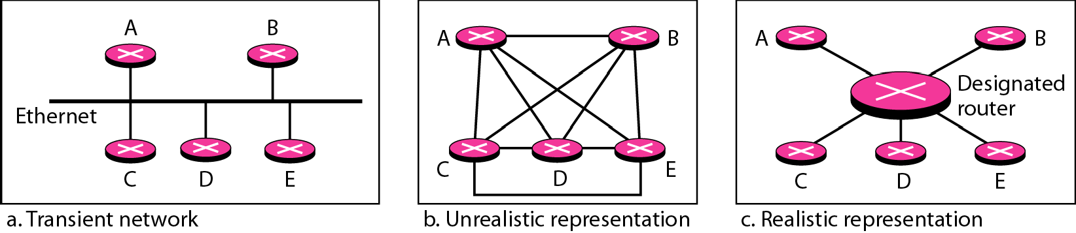
Transient link

Slide 13
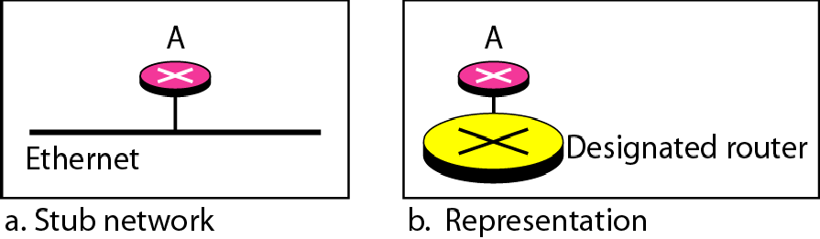
Stub link

Slide 14
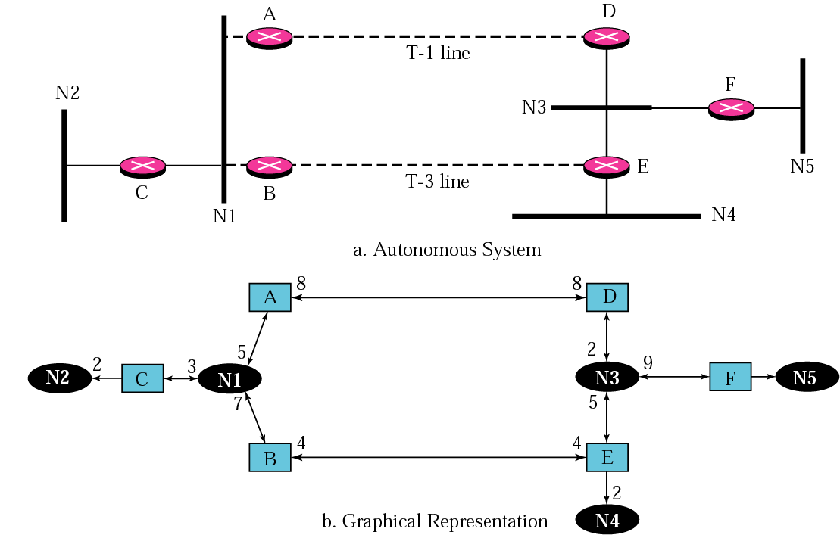
Figure Example of an AS and its graphical representation in OSPF

Slide 15
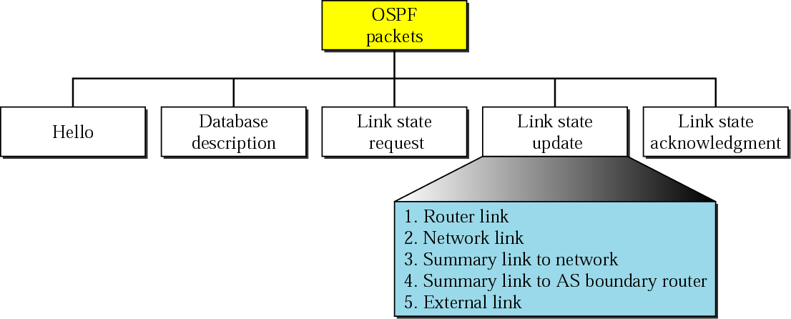
Figure Types of OSPF packets

Slide 16
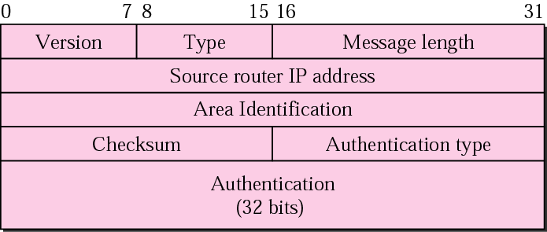
Figure OSPF common header

Slide 17
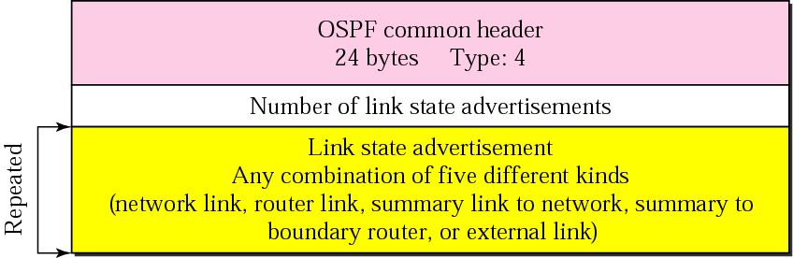
Figure Link state update packet

Slide 18
Note:
OSPF packets are encapsulated in IP datagrams.

